Slide 1

JAVA
BUILD TOOLS

Slide 2



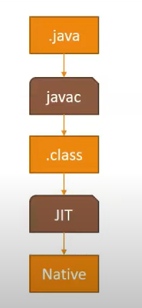



Create Source Code
Java programs are created and are saved as .java files
Compile Source Code
Run javac to create a bytecode for the program and will output .class file. All systems, even modern ones, invoke javac to compile codes.
Convert the bytecode into machine language
Create an operating system specific codes. Use JIT compiler to create a Native code of the program so it can run.
OLD SCHOOL

Slide 3
Java Build Platform Comparison
BUILD TYPE | USES | CONFIGURATION FILE
javac | Creates bytecode | none
IDE | Builds for IDE | none
Ant | Script (file movements, etc) | build.xml
Maven | Dependencies, Versioning | pom.xml
Gradle | Dependencies, Versioning | build.gradle

Slide 4







JAVAC
Create a java source code
Compile the source code
javac HelloWorld.java
Run the program
java HelloWorld.java
or
java -classpath . HelloWorld
-classpath is a flag that looks for the HelloWorld
. is the current directory

Slide 5








IDE
Create a project
Build project
Create a well-structured project with multiple java files and other necessary files
Builds all the files that need to be compiled

Slide 6




APACHE ANT
ANT is Another Neat Tool
ANT is the first tool for building Java applications.
It’s build scripts are written in XML
Ant is extremely flexible and does not impose coding conventions or directory layouts to the Java projects which adopt it as a build tool.
Software development projects looking for a solution combining build tool and dependency management can use Ant in combination with Apache Ivy.
ANT Tutorial: https://www.tutorialspoint.com/ant/index.htm

Slide 7

APACHE IVY
Apache Ivy™ is a very powerful dependency manager oriented toward Java™ dependency management, although it can be used to manage dependencies of any kind.
Apache IVY is a dependencies management tool similar to Maven but is ANT based. It is highly flexible and configurable similar to ANT and easy to use as Maven.
ANT Tutorial: https://www.tutorialspoint.com/ant/index.htm

